Slide 1
Xbox One Controller
Xinput library

Slide 2
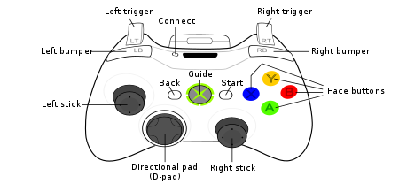
Notes:
https://commons.wikimedia.org/wiki/File:360_controller.svg

Slide 3


Buttons
GAMEPAD_DPAD_UP = 0x0001
GAMEPAD_DPAD_DOWN = 0x0002
GAMEPAD_DPAD_LEFT = 0x0004
GAMEPAD_DPAD_RIGHT = 0x0008
GAMEPAD_DPAD_UP | GAMEPAD_DPAD_LEFT = 0x1 | 0x4 = ${\left(05\right)}_{10}$
GAMEPAD_DPAD_UP | GAMEPAD_DPAD_RIGHT = 0x1 | 0x8 = ${\left(09\right)}_{10}$
GAMEPAD_DPAD_DOWN | GAMEPAD_DPAD_LEFT = 0x2 | 0x4 = ${\left(06\right)}_{10}$
GAMEPAD_DPAD_DOWN | GAMEPAD_DPAD_RIGHT = 0x2 | 0x8 = ${\left(10\right)}_{10}$

Slide 4

Analog buttons
Left trigger and right trigger:
Min value: 0
Max value: 255
Left thumb and right thumb (x, y) :
$− 32767 ≤ x , y ≤ + 32767$
Suggested dead zone: 8689

Slide 5
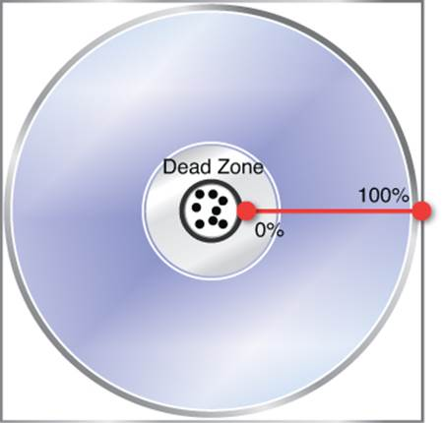



Left and right thumb dead zones
$$magnitude =\sqrt{x^{2}+y^{2}}$$
if magnitude > DEAD_ZONE: do_some_action()
else: pass
$$normalized_x =\frac{x}{magnitude}$$
$$normalized_y =\frac{y}{magnitude}$$
Notes:
https://bell0bytes.eu/xinput-and-gamepads/

Slide 6
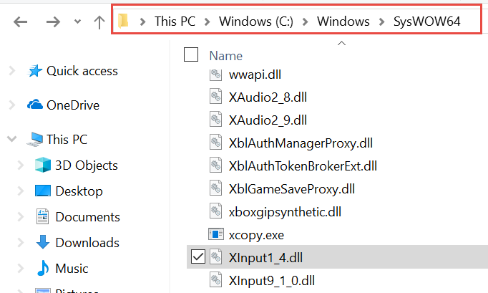
Xinput Library
Built by Microsoft for Windows and comes with DirectX (9+)
XInput supports a maximum of four controllers at a time. In our demo we only use one
XInput is provided as a DLL library (dynamic link library) for C and C++ programs
We use ctypes library in python to access dll files

Slide 7
Xinput Library
unsigned long XInputGetState(unsigned long , XINPUT_STATE*);
typedef struct XINPUT_STATE { unsigned long dwPacketNumber; XINPUT_GAMEPAD Gamepad; }; typedef struct XINPUT_GAMEPAD { unsigned long wButtons; unsigned byte bLeftTrigger; unsigned byte bRightTrigger; short sThumbLX; short sThumbLY; short sThumbRX; short sThumbRY; };

Slide 8
XINPUT_GAMEPAD python dictionary
{
"buttons": 20480,
"left_trigger": 255,
"right_trigger": 73,
"l_thumb_x": -11272,
"l_thumb_y": -15314,
"r_thumb_x": 32074,
"r_thumb_y": 16753
}

Slide 9
Xbox one controller + Cozmo
robot.drive_wheels(left_speed, right_speed)
(100, 100)
(50, 100)
(100, 50)
(-100, 100)
(100, -100)
(-50, -100)
(-100, -50)
(-100, -100)

Slide 10
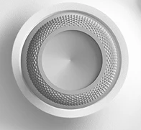
Xbox one controller + Cozmo
robot.drive_wheels(left_speed, right_speed)
(100, 100)
(50, 100)
(100, 50)
(-100, 100)
(100, -100)
(-50, -100)
(-100, -50)
(-100, -100)

Slide 11
Task 1: Right and left bumper buttons
Implement a boost feature for movement speed
- While the right bumper is pressed, the speed increases
While the left bumper is pressed, the speed decreases
Otherwise the default speed is used

Slide 12
Task 2: Right thumb
Move the robot in the direction of the right thumb as follows:

Slide 13

Task 3: Robot racing
Notes:
https://www.wired.com/2014/09/the-ultra-fast-f1-track-where-the-biggest-problem-is-slowing-down/

Slide 14
References
XInput and Gamepads By Gilles Bellot - June 25, 2018 https://bell0bytes.eu/xinput-and-gamepads/
Getting Started With XInput 05/30/2018 https://docs.microsoft.com/en-us/windows/desktop/xinput/getting-started-with-xinput

